Slide 1
Crystal Basin Cellars
Award-Winning Winery & Business Operation
$4.1M Total | $1.1M Business | 25 Years in Business

Slide 2
Opportunity Snapshot
• Fully operational medal-winning winery
• Loyal customer base & 2 retail locations
• 1,400+ wine club members
• 40+ Gold Medals
• Scalable production infrastructure

Slide 3
Business Metrics
• Annual Revenue: ~$1.4M
• Business Asking Price: $1.1M
• Total Offering: $4.1M
• Inventory: 12,000 cases bottled, 7,000 in barrel
• Climate-controlled storage for 25,000 cases

Slide 4
Equipment & Capacity
• 250 tons/year | 35,000 gallons
• 6,000-gallon tank capacity (non-jacketed)
• Includes: 2 trucks, forklift, 70kW generator
• 450 used barrels

Slide 5
Financial Snapshot
• Wine Club Revenue: $550K
• Tasting Room Revenue: <$50K
• Indirect Costs: $150K
• Minimal Debt: < $10K grape payables

Slide 6
Brand Strength
• Over 40 gold medals
• Focus on sourcing premium El Dorado grapes
• 25+ successful harvests
• Proven reputation for quality winemaking

Slide 7
Real Estate & Infrastructure
• 3.62 acres unrestricted commercial land
• ~17,000 sf of permitted space
• 4 tasting rooms, winery, brewery, patios
• $73K/month rental income from long-term leases

Slide 8
Growth Potential
• Expand DTC outreach and wine club
• Leverage brand for broader distribution
• Increase tasting/event revenue
• Expand production beyond 250 tons

Slide 9
Contact Information
Steve Rath
Optima Steel International
(916) 817-7016
Crystal Basin Cellars
www.crystalbasin.com
Financials and varietal portfolio available upon request

Slide 10
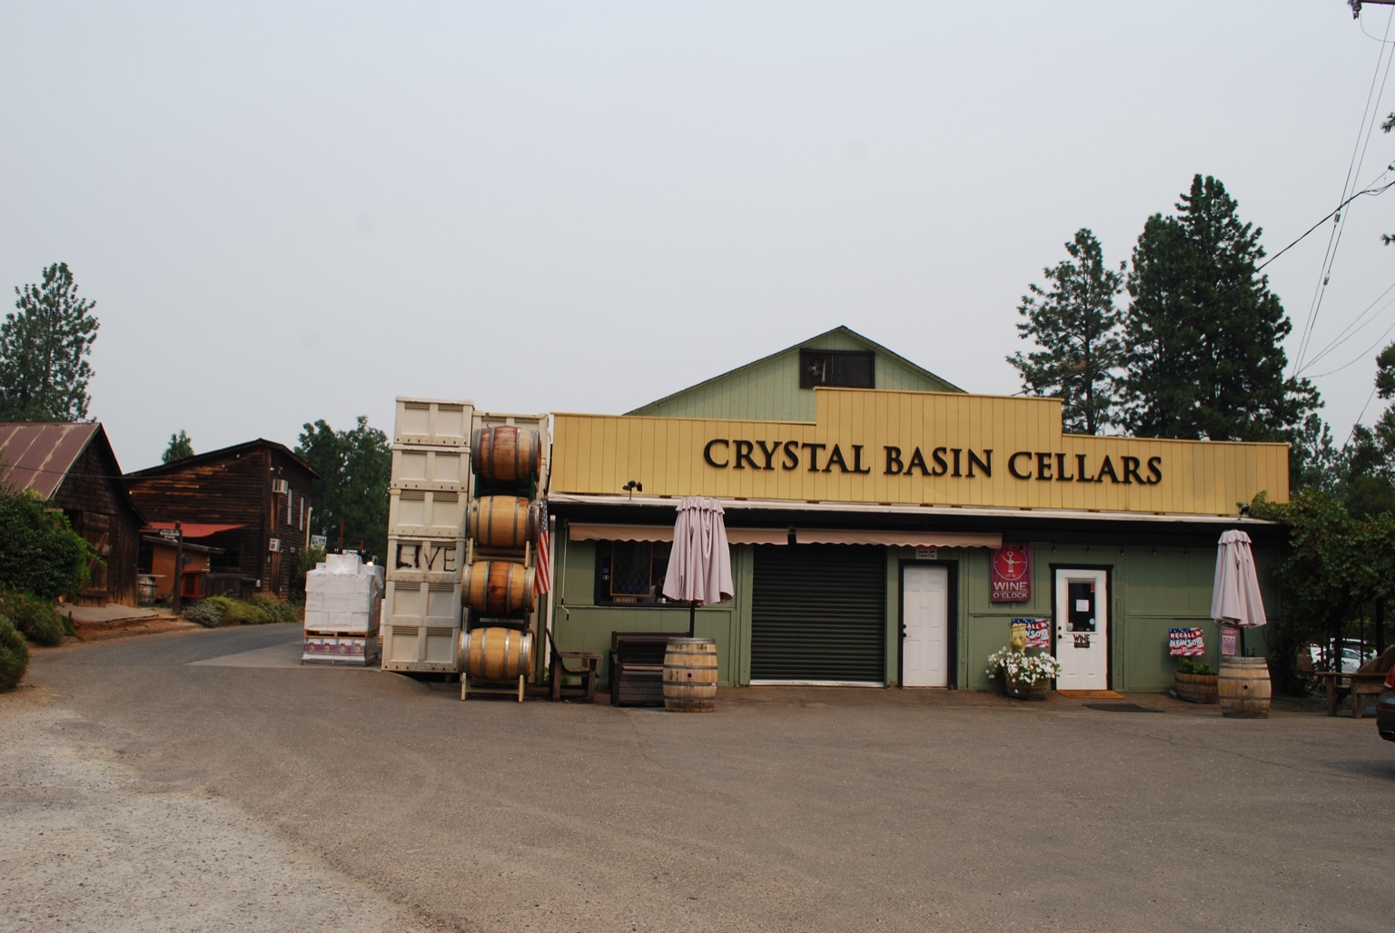

Slide 11
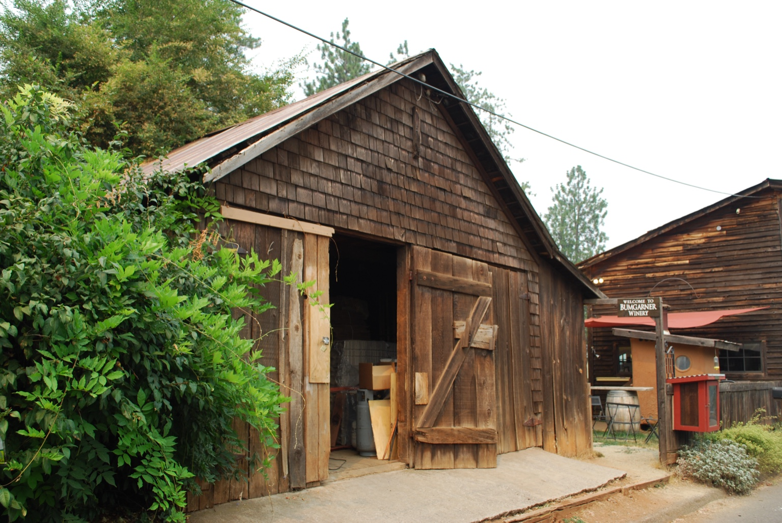

Slide 12
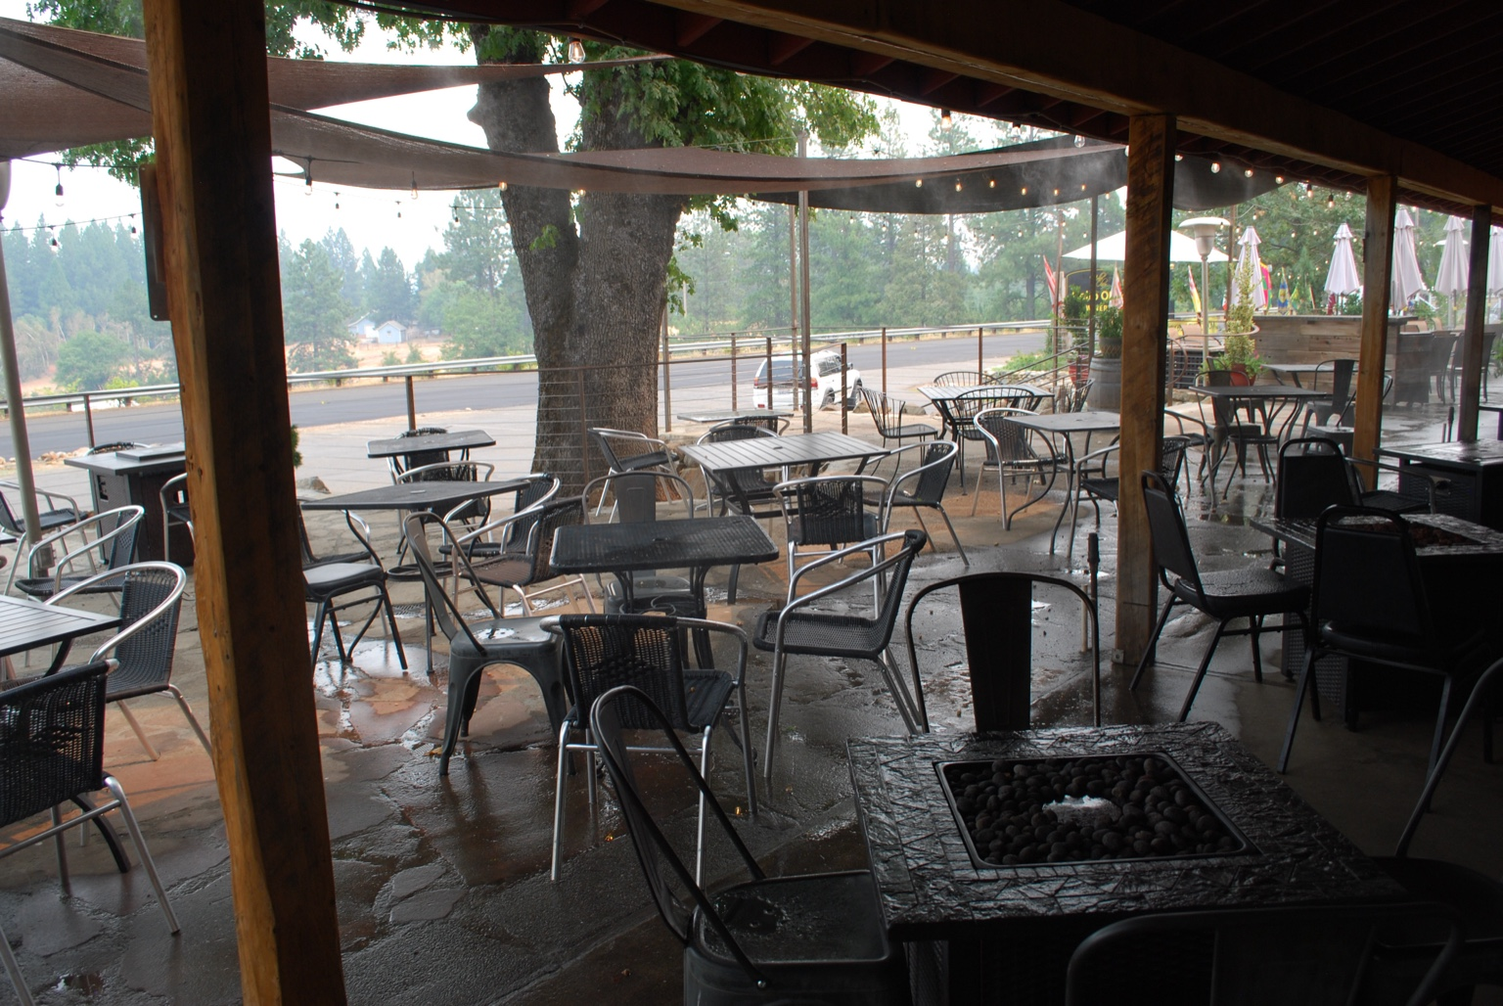

Slide 13
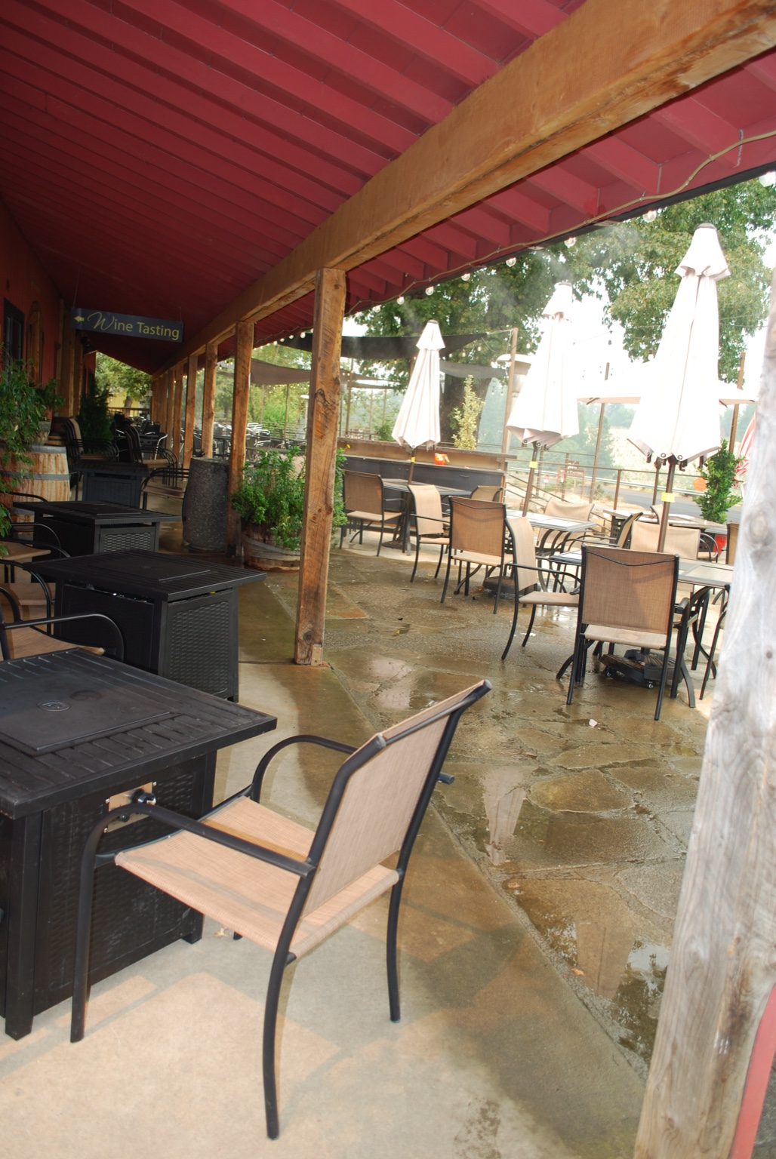

Slide 14
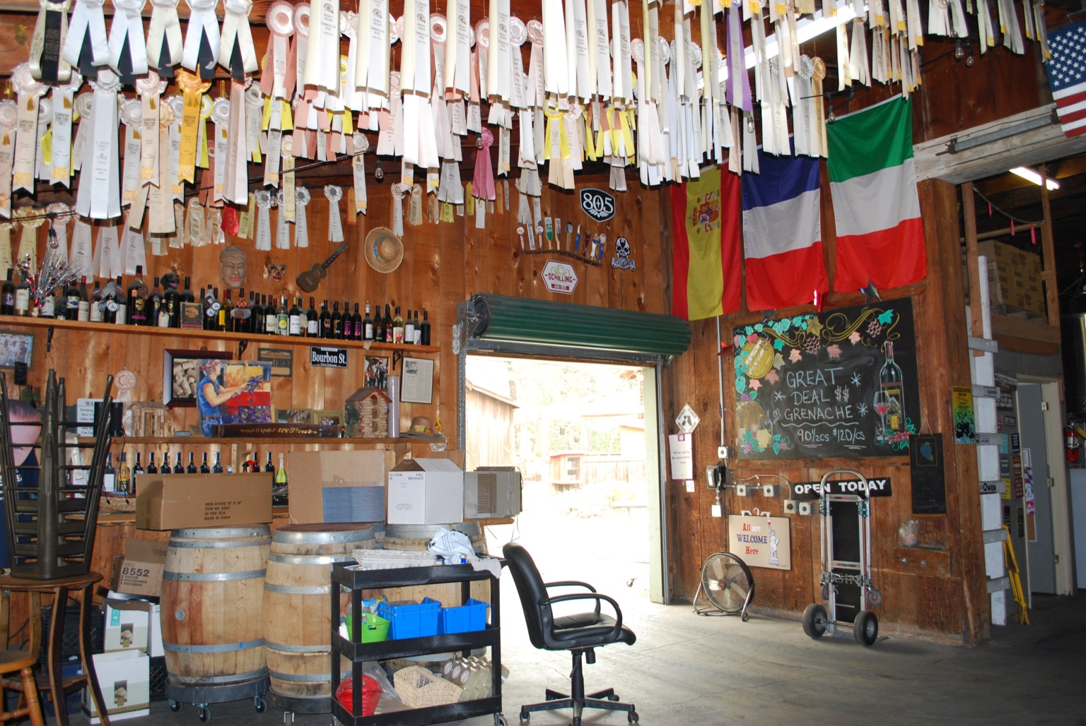

Slide 15
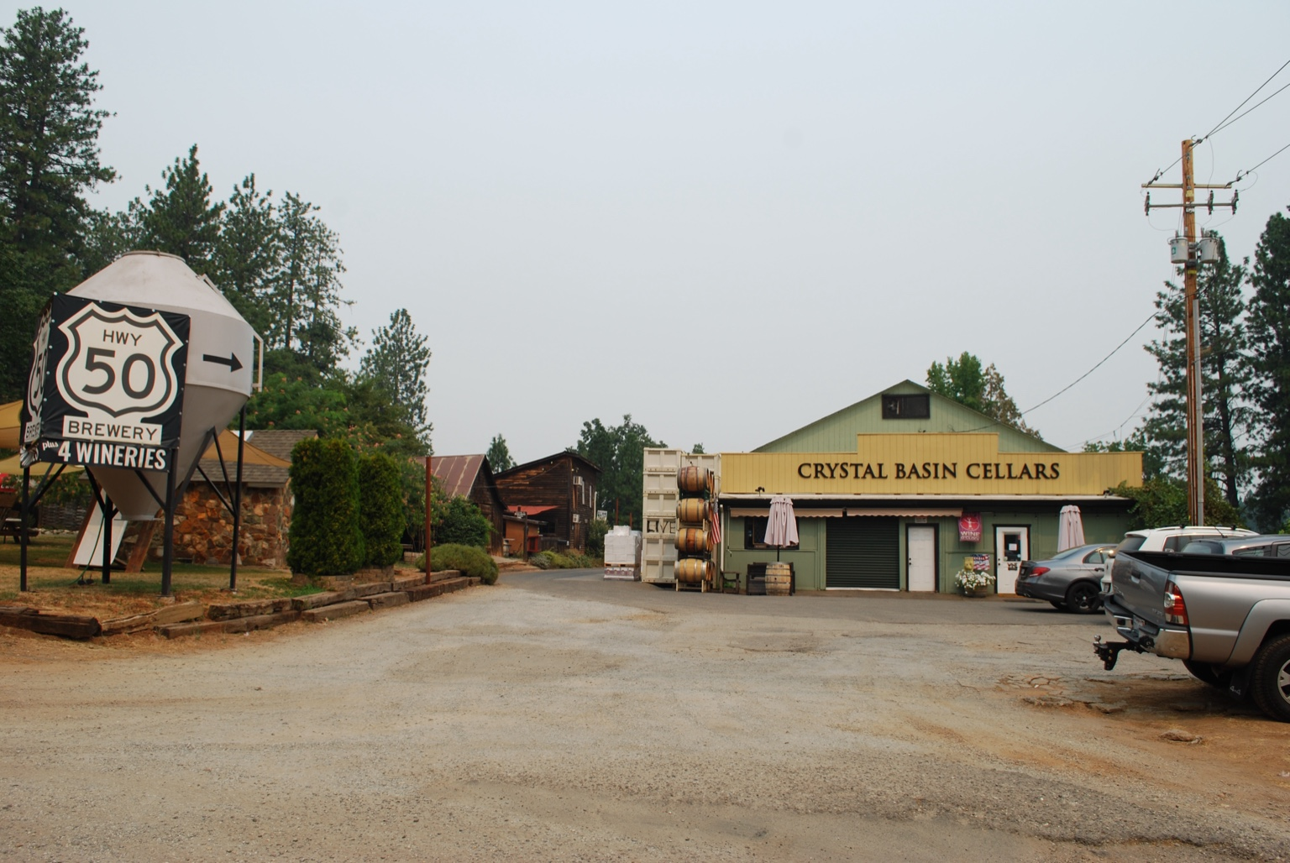

Slide 16
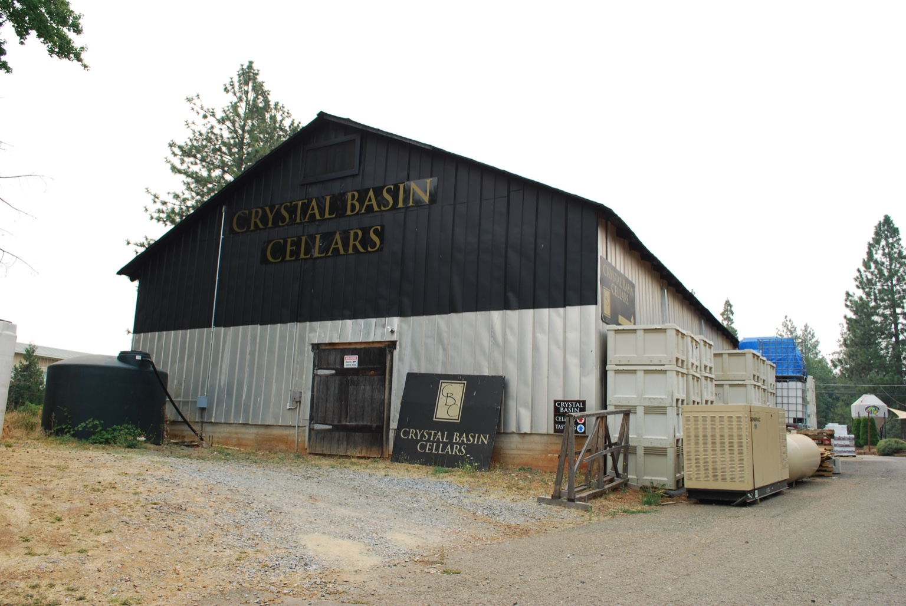

Slide 17
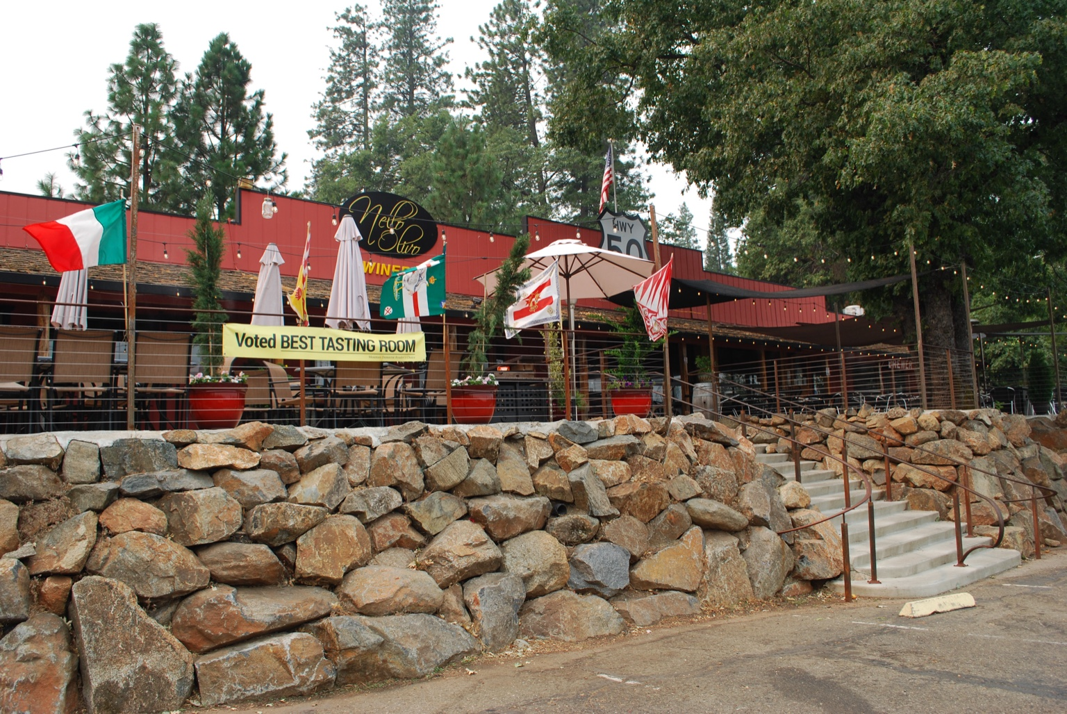

Slide 18
